Slide 1
Lecture 01: Introduction
Chris Walshaw
Computing & Mathematical Sciences
University of Greenwich

Slide 2
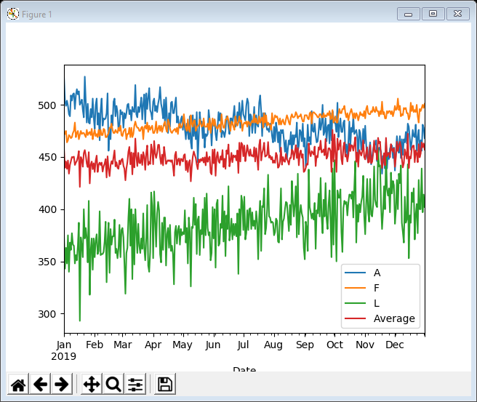
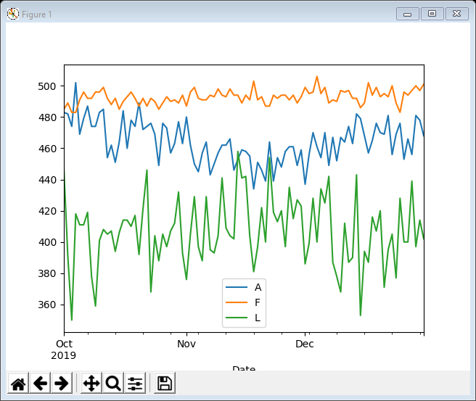
Motivation / Objectives
A quick introduction to visualisation
what is visualisation?
why visualise?
what does visualisation involve?
some examples
A preliminary data exploration of a (fictional) company’s sales data
looking at data wrangling tools

Slide 3
What is information / data visualisation?
Information visualisation “is the study of visual representations of abstract data to reinforce human cognition” [Wikipedia]
Data visualisation is the “visual representation and presentation of data to facilitate understanding” [Kirk]
Data visualisation vs information visualisation
the two terms are often used interchangeably but strictly speaking information visualisation also covers knowledge visualisation (e.g. mind maps)
here we focus on data visualisation
Information visualisation vs infographics?
on websites and in the media (books / newspapers / TV) you often encounter infographics
typically infographics are manually constructed and contain text as well as visuals – they cannot be easily transferred to different data
Visualisation vs visualization
“visualization” is the only correct spelling in American English
“visualisation" and "visualization" are both acceptable in British English although it is a common misconception that "visualization" is an Americanism and therefore incorrect
best pick one and stick to it

Slide 4
What does visualisation involve?
Typically visualisation involves visual data exploration and / or explanation / presentation
Visual data exploration vs visual data explanation?
data exploration uses visual tools to understand what is in a dataset and the characteristics of the data
data explanation uses visual tools to present / explain the results of data analysis and may follow on after exploration
we shall focus on visual data exploration
Visual data exploration usually involves
data cleaning
data wrangling
visualisation (often trivial if you get 1. and 2. right)
However this course is not about data cleaning
although this is massively important task, we don’t have time to cover it

Slide 5
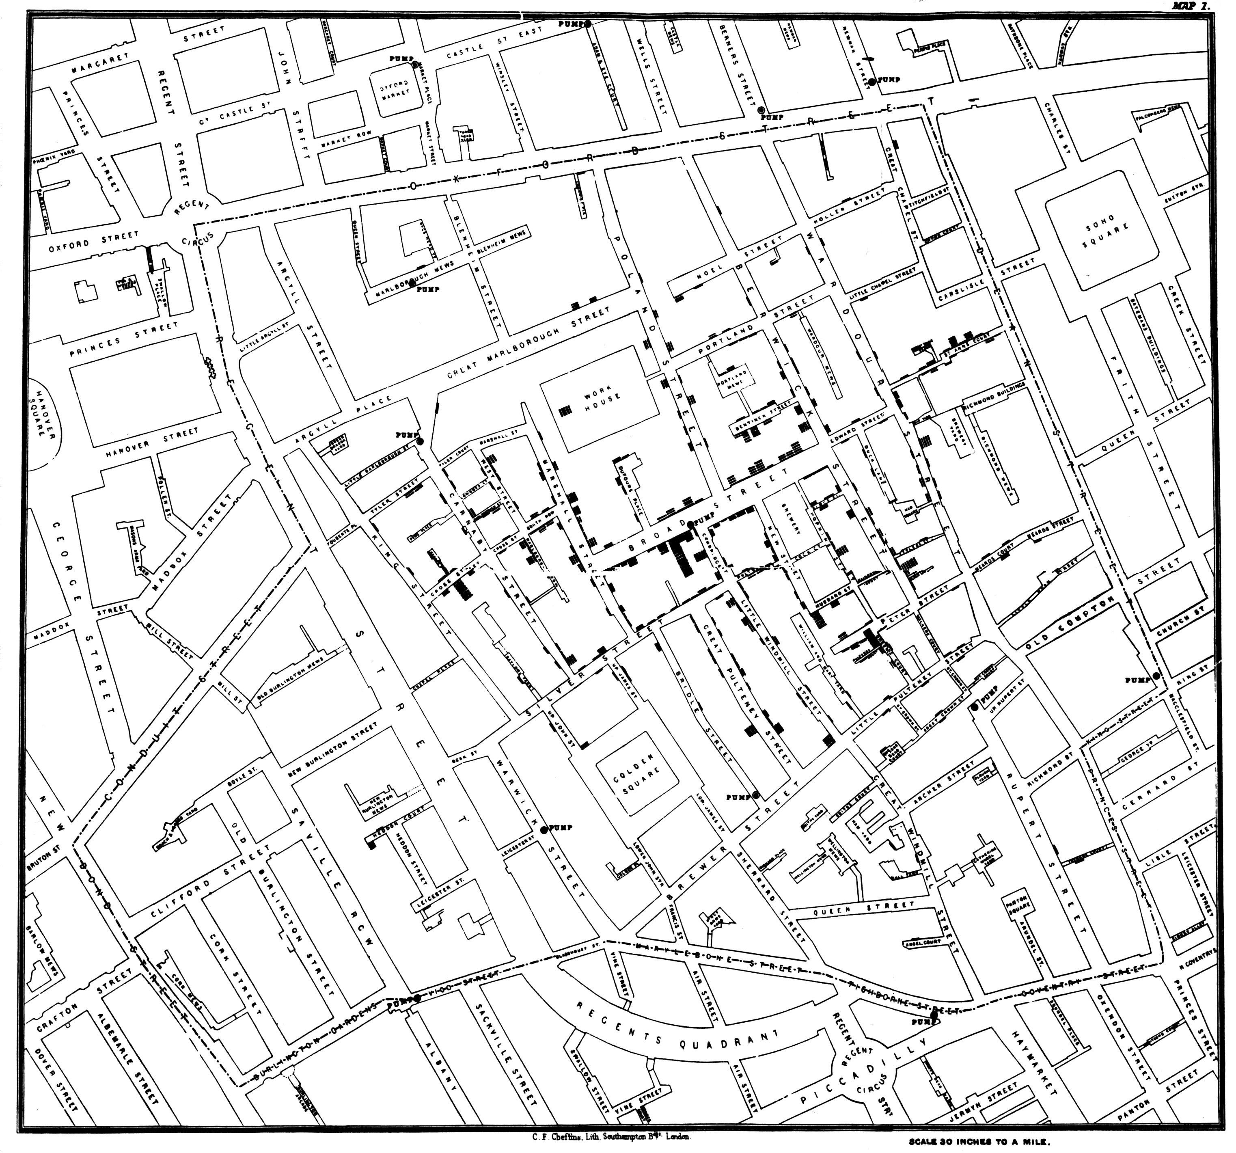
Some examples – early visual data exploration
One of the earliest and most famous visualisation examples was done by Dr John Snow in London, 1854
he plotted a cluster cholera deaths on a map – the visualisation suggested the source of the cholera was a water pump located at the centre of the cluster
More info (and an interactive map) at theguardian.com/news/datablog/2013/mar/15/john-snow-cholera-map

Slide 6
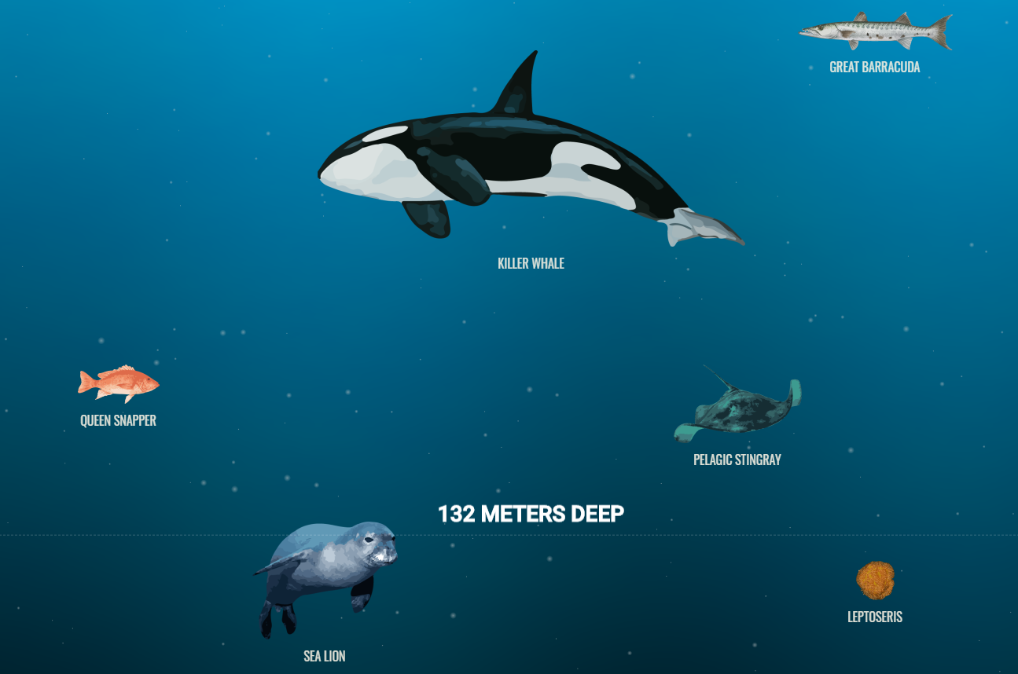
Some examples - infographic
In recent years, the availability of data and proliferation of tools have made visualisation very popular & accessible
potentially offering well-paid careers as a data scientist
A beautiful recent example is The Deep Sea, by Neal Agarwal
https://neal.fun/deep-sea/
This is a form of infographic – not easily transferable to other data

Slide 7
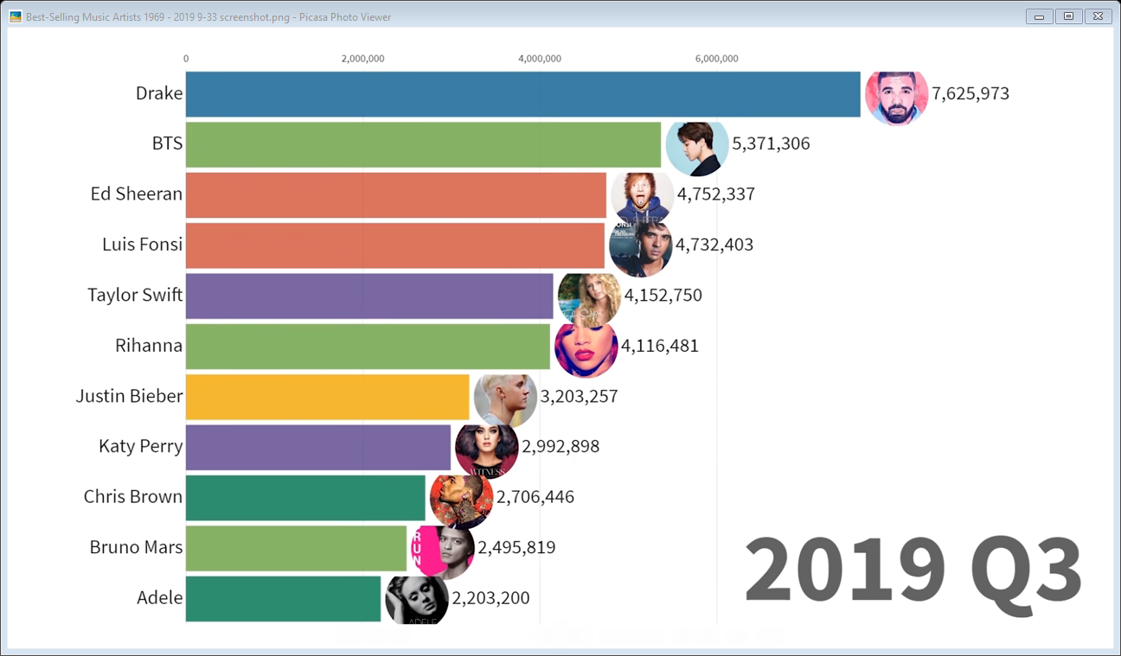
Some examples – data explanation / presentation
On the other hand the Data is Beautiful youtube channel uses the same code to provide animated visualisations of lots of different datasets
e.g. Best Selling Music Artists 1969-2019 https://www.youtube.com/watch?v=a3w8I8boc_I
This is an example of data presentation / explanation
most of our visualisations will look more like this one than the other examples
but not animated ☹ (a bit advanced for this course)
and without so many pictures of pop stars

Slide 8
Visualisation vs statistics
In the past visualisation was regarded as imprecise and ill-defined
Instead statistics were regarded as a more scientific and rigorous way to understand data
e.g. maximum, minimum, average, standard deviation, …
In 1973 Anscombe created a (tiny) dataset to explode this belief
the dataset consists of 4 subsets, each with just 11 x/y pairs of numbers
All 4 subsets have exactly the same statistics, so for each subset
x mean = 9.00, y mean = 7.50 (the mean is the average value)
x standard deviation = 3.16, y standard deviation = 1.94 (standard deviation measures how much the values vary from the mean)
the linear regression values are all the same (linear regression computes a trend-line – see later in the course)
So a statistician might conclude that the 4 subsets are essentially the same data …

Slide 9
Anscombe’s quartet
… but when we visualise the data … demo (Example 01)
Of course it’s possible to detect that the values are very different without visualising the data
but what if there were 1100 values in each subset, or 11,000, or 11,000,000, …
In fact humans are visual creatures
we have spent millions of years evolving ways to recognise patterns (e.g. tiger stripes!), relative sizes, colours, etc
Visualisation can still be misleading or inconclusive … but then so can statistics
both depend on how you choose to process the data

Slide 10
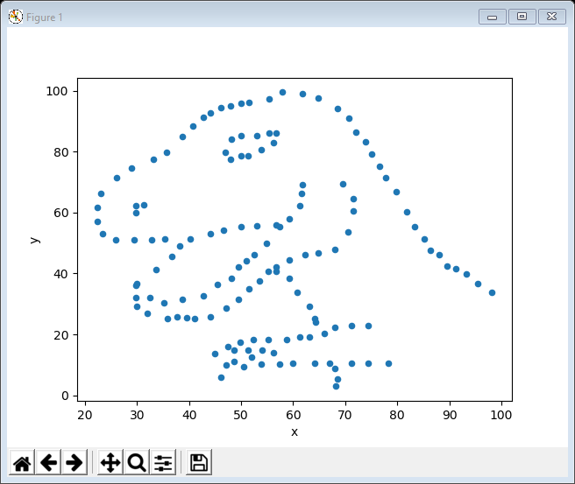
Cairo’s dataset
More recently (in 2017) Albert Cairo created another tiny demonstrative dataset (142 x/y pairs of values)
The statistics for the values suggest that
x has slightly larger values (mean x = 54.26 vs 47.83 for y)
x has a narrower range (min x = 22.31, max x = 98.20 vs min y = 2.95, max y = 99.49)
hence x has smaller standard deviation (std. dev. for x = 16.76 vs 26.93 for y)
We can even visualise them as line plots but not particularly revealing – demo (Example 02)
However, when we visualise them as a scatter plot …
Moral 1: never trust statistics alone, always visualise your data (don’t get bitten by the datasaurus!) …
Moral 2: … but not all visualisations are helpful … what if we gave up after the line plot?

Slide 11
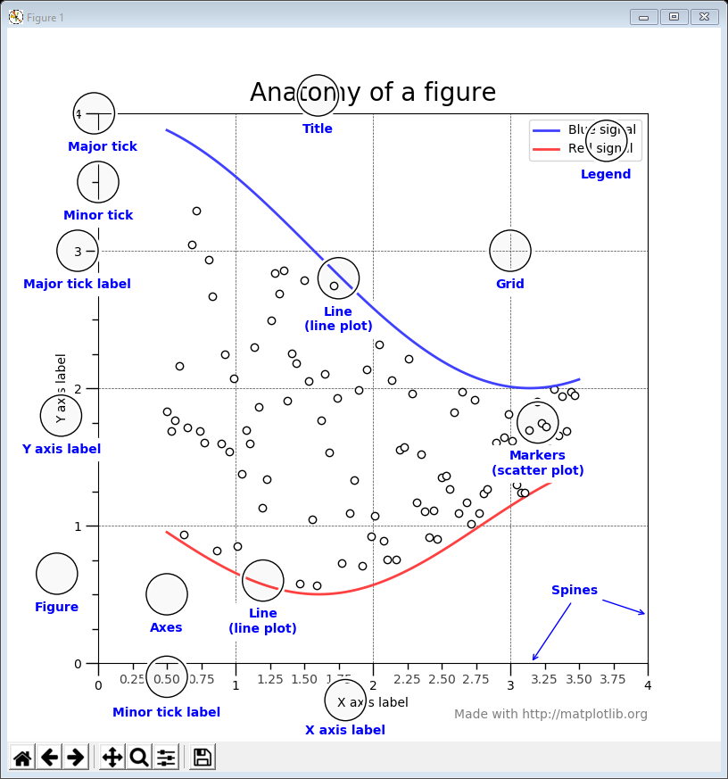
Visualisation Technologies
It’s possible to do data visualisation in Excel / Tableau but typically the techniques are not transferable from one dataset to another
unlike in Python / R where we can build a script and then apply it to another similar dataset (e.g. apply the same script to different years)
There are many Python / R libraries available to do visualisation, e.g.
Python: MatPlotLib / Pandas / Bokeh / Panel / HvPlot
Python: Plotly / Dash
R: ggplot / Shiny
We will focus on the first set of libraries and meet them gradually throughout the course
Example 03 shows an example MatPlotLib plot with useful terminology (legend, ticks, labels, etc)

Slide 12
An introductory data exploration
We will spend the rest of the lecture getting acquainted with MatPlotLib and Pandas
MatPlotLib is perhaps the most well known Python visualisation library
stands for Mathematical Plotting Library – see https://matplotlib.org/
Pandas is a fundamental part of the data explorer’s toolkit
stands for Panel Data(?) – see https://pandas.pydata.org/
allows you to read data into a spreadsheet-like Python object – e.g. with named columns and rows – called a DataFrame
the DataFrame allows you to easily manipulate data, using row and column-based operations
has a simple interface to MatPlotLib visualisations

Slide 13
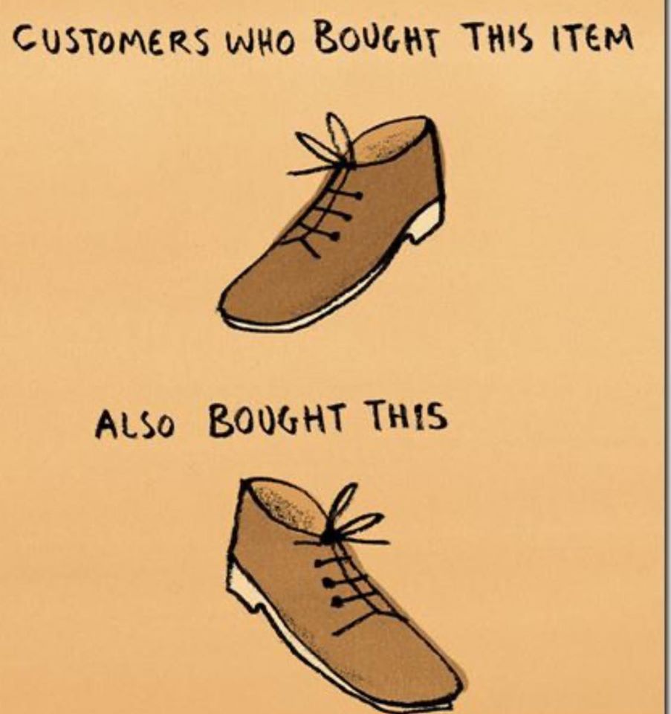
The data
We will use these tools to explore the sales data from a fictional company called ChrisCo
we will be looking at the same data through the term and ChrisCo’s website data in the tutorials
ChrisCo sells 25 different products, labelled A to Y and has provided daily sales data for each product on each day of 2019
the sales are online (and also fictional) so they even sell at weekends and public holidays
so there are a total of 25 (one for each product) x 365 (one for each day of the year) = 9,125 data points
the data is pre-cleaned and relatively straightforward (real data might require cleaning – i.e. removing missing values, and could be harder to analyse)
ChrisCo is interested in understanding what the data shows, for example products that …
have declining sales
aren’t very profitable
cost too much to market
can be sold together

Slide 14
Getting started
In a typical data exploration, the first step is to read in the data and print out some details to see what size / shape it is
Pandas has a function .read_csv() for reading in a .csv file
just need to say which column contains the index (i.e. the names of each row)
usually this will just be column 0 (or the data might not have an index)
Pandas also has several functions for understanding the data, e.g.
.head() returns the first few rows or, for example, .head(10) returns the first 10 rows
.tail() returns the last few rows
.shape contains the number of rows & columns
.describe() calculates some statistics
.sum() calculates the sum of each column
We can print them out with the Python print() command

Slide 15
04Data.py – data description
Here’s the entire code of example 04
First read the file in
Then convert the index to date objects (rather than strings - useful later)
The output will tell us a lot about the data – demo
We will use the same basic code in the rest of the examples (but not print so many details)
import matplotlib.pyplot as plt
import pandas as pd
data = pd.read_csv('https://tinyurl.com/ChrisCoDV/Products/DailySales.csv',
index_col=0)
data.index = pd.to_datetime(data.index)
print(data)
print(data.head())
print(data.tail())
print(data.describe())
print(data.sum())

Slide 16
05Data sorting.py
Sorting by rows / columns is easy and gives more insight
Looking at the results
the quietest day for sales was Feb 6th (total 470)
the busiest day for sales was Jan 22nd (total 527)
the best selling products are F, A & L with ~170,000 to 140,000 sales over the year – all others have < 100,000
the worst selling products are K, U & R with ~3,300 to 2,400 sales over the year
# sort the data according to the maximum value of each row, smallest first
data = data.reindex(data.max(axis=1).sort_values().index)
print(data.max(axis=1))
print(data.head())
# sort the data according to the sum of each column, largest first
data = data.reindex(data.sum().sort_values(ascending=False).index, axis=1)
print(data.sum())
print(data.head())

Slide 17
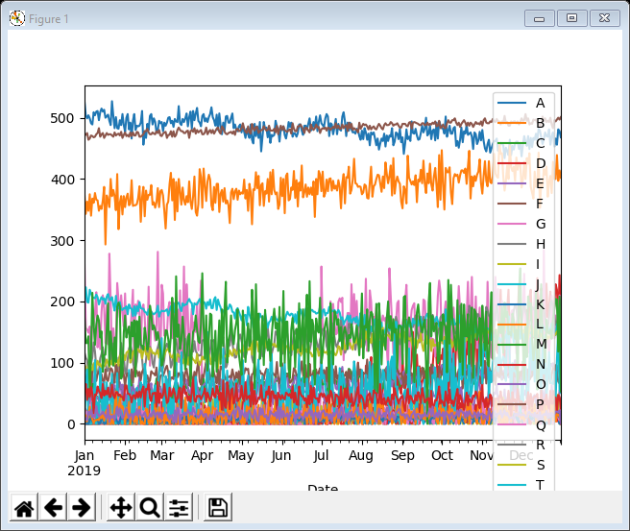
06Data plotting.py
However, this is a visualisation course – let’s do some basic plots
we won’t try to interpret the plots – that comes later in the course
Then the plotting is easy – demo
If you are a programmer, this looks a bit weird
tell the data to plot something (box, density, line)
tell MatPlotLib to show the plot
It’s because Pandas uses MatPlotLib to do the plots
although in jupyter there’s a way of avoiding the plt.show() instructions
We are not intending to interpret the plots at this stage, but it doesn’t take a genius to see that they have TMI … Too Much Information!!
data.plot.box()
plt.show()
data.plot.density()
plt.show()
data.plot.line()
plt.show()

Slide 18
07Data column selection by name.py
A major part of the data exploration role is dealing with too much information
we shall use a number of simple techniques … selection, filtering, segmentation, …
Selection by column name is easy
we know that products A, F & L have the most sales – let’s focus on them
Here we have replaced our original dataframe with a new one that just contains columns A, F & L
both dataframes are referred to by the same name (data), but once we have done the replacement we no longer have access to any of the other columns …
… unless we read the data in again
selected = ['A', 'F', 'L']
data = data[selected]
print(data.head())
data.plot.box()
plt.show()
data.plot.density()
plt.show()
data.plot.line()
plt.show()

Slide 19
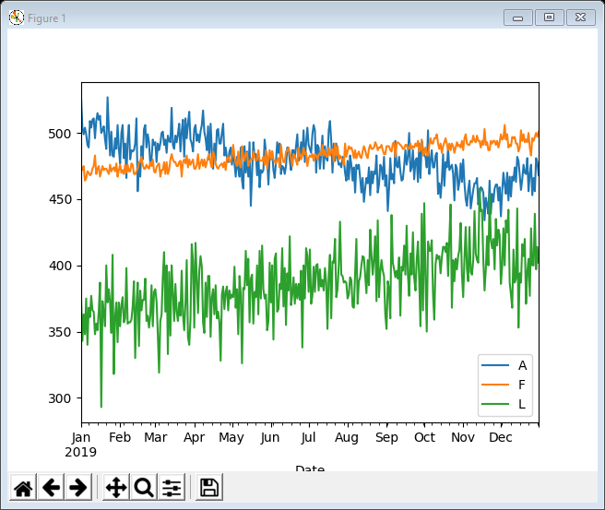
07Data column selection by name.py
now the data is easier to understand
we can see that product A actually had higher sales than F initially … but they are declining gradually
whereas both F and L are growing (although F is steadier)

Slide 20
08Data column filtering by name.py
Instead of replacing the original dataframe we can just use a filtered version (with columns A, F & L ) whenever we need
this leaves the original dataframe available in case we want to use it again
The changes are shown in bold – we just use data[selected] to do the plots
The plots are unchanged from the previous example
selected = ['A', 'F', 'L']
print(data[selected].head())
print(data.head())
data[selected].plot.box()
plt.show()
data[selected].plot.density()
plt.show()
data[selected].plot.line()
plt.show()

Slide 21
09Data column selection by value.py
Selecting columns by name is fine if there are just 25 columns
but what if there are 250 or 25,000?
Another way to do this is to select columns by value
We know from example 04 that products A, F & L are the only ones with more than 100,000 sales over the year
We just set the selected columns to those where the column sum is larger than 100,000
Apart from that the code and the output is the same as example 07
selected = data.columns[data.sum() > 100000]
data = data[selected]
print(data.head())
data.plot.box()
plt.show()
data.plot.density()
plt.show()
data.plot.line()
plt.show()

Slide 22
10Data column segmentation by value.py
Once we have created a dataframe with columns A, F & L we might want to turn our attention to the rest of the data
this is easy using .drop() to get rid of the columns we don’t want
Now
data_selected1 is a dataframe containing columns A, F & L
data is a dataframe containing everything except A, F & L
This gives us a dataset segmented into 2 mutually exclusive pieces
selected = data.columns[data.sum() > 100000]
data_selected1 = data[selected]
data = data.drop(selected, axis=1)
print(data_selected1.head())
print(data.head())
data_selected1.plot.line()
plt.show()

Slide 23
10Data column segmentation … (cont’d)
We can repeat this process to segment further
Now
data_selected1 is a dataframe containing columns A, F & L
data_selected2 is a dataframe containing columns G, H, J, S & W
data is a dataframe containing everything except the above
This gives us a dataset segmented into 3 mutually exclusive pieces
selected = data.columns[data.sum() > 40000]
data_selected2 = data[selected]
data = data.drop(selected, axis=1)
print(data_selected2.head())
print(data.head())
data_selected2.plot.line()
plt.show()

Slide 24
10Data column segmentation … (cont’d)
And further
Now
data_selected1 is a dataframe containing columns A, F & L
data_selected2 is a dataframe containing columns G, H, J, S & W
data_selected3 is a dataframe containing columns D, E, M, O, P, T, X
data is a dataframe containing everything except the above – in fact that just leaves B, C, I, K, N, Q, R, U, V & Y
This gives us a dataset segmented into 4 mutually exclusive pieces
Segmentation is a powerful tool for data exploration – demo
selected = data.columns[data.sum() > 10000]
data_selected3 = data[selected]
data = data.drop(selected, axis=1)
print(data_selected3.head())
print(data.head())
data_selected3.plot.line()
plt.show()

Slide 25
11Data column augmentation.py
It is also easy to add extra columns if you need them
We restrict the dataframe columns A, F & L
Then we add an extra column called Average which contains the mean (average) of the other 3 columns
The resulting visualisation shows that although A is declining, on average sales of the top 3 products are growing slowly (red line)
selected = ['A', 'F', 'L']
data = data[selected]
print(data.head())
data['Average'] = data.mean(axis=1)
print(data.head())
data.plot.line()
plt.show()

Slide 26
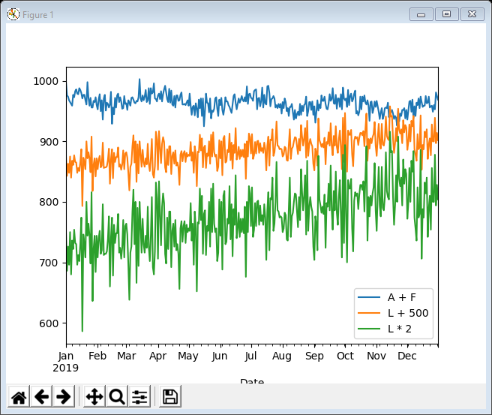
12Data column manipulation.py
We can also do manipulations / calculation with whole columns – helps to answer questions about how the data might behave, e.g.
what happens if we sell products A & F together
what happens if we advertise product L and manage to sell 500 extra per day
what happens if we advertise product L and manage to double sales
We can drop the original columns and visualise the “what if” data
Of course we don’t know how combining A & F will affect sales and we don’t know if it’s even possible to sell 500 more Ls a day
selected = ['A', 'F', 'L']
data = data[selected]
print(data.head())
data['A + F'] = data['A'] + data['F']
data['L + 500'] = data['L'] + 500
data['L * 2'] = data['L'] * 2
data = data.drop(selected, axis=1)
print(data.head())

Slide 27
13Data row selection by range.py
Throughout the course we will mostly focus on manipulating columns
However, it’s equally possible to select, filter, segment, augment and manipulate by rows
The next example selects columns A, F & L as before and then uses .loc() to restrict the rows of the dataframe to a range of dates, 1st Oct to 31st Dec
The resulting visualisation shows us sales of A, F & L in the last quarter of the year
selected = ['A', 'F', 'L']
data = data[selected]
data = data.loc[pd.to_datetime('2019-10-01’)
: pd.to_datetime('2019-12-31')]
print(data.head())

Slide 28
14Data transposition.py
Given we are going to deal mostly with columns … what happens if the dataset is organised in rows
e.g. what if each column represents a date and each row a product, rather than the other way around
Easy … just .transpose() the data
selected = ['A', 'F', 'L']
data = data[selected]
data = data.loc[pd.to_datetime('2019-01-01'): pd.to_datetime('2019-01-07')]
print(data.head())
data.sum().plot.bar()
plt.show()
data = data.transpose()
print(data)
ax = data.sum().plot.bar()
plt.gcf().autofmt_xdate()
plt.show()

Slide 29
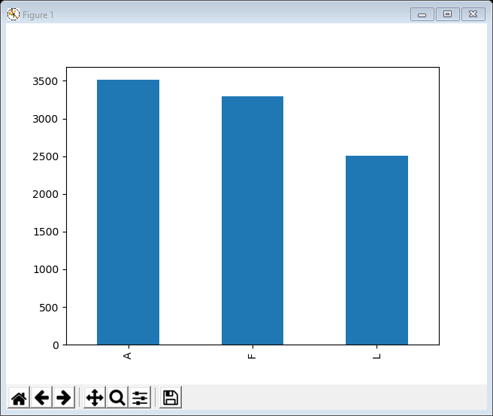
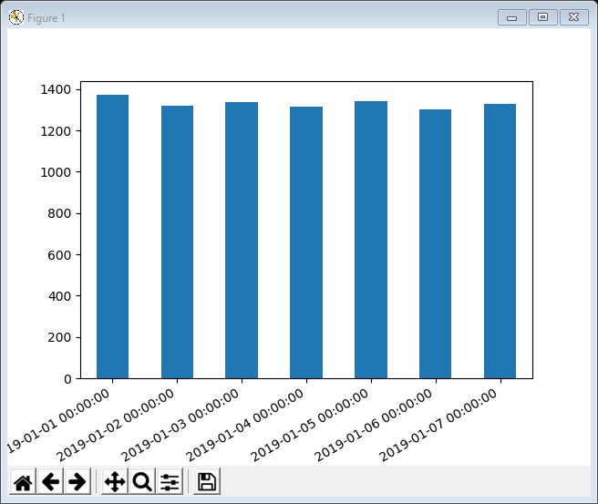
14Data transposition.py
the first bar plot shows total sales of A, F & L restricted to 1st-7th Jan
but once we transpose the bar plot shows total sales (of A, F & L) on each day, 1st-7th Jan

Slide 30
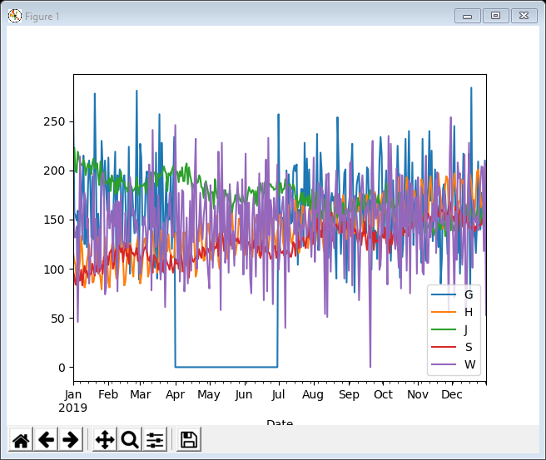
Data conclusions
We are not making business decisions
the data scientist’s role is to explore the data
let the business analyst decide what to do
And we haven’t really started exploring the data properly yet (wait until next week)
However …
easy to identify the best selling A, F & L products and then select / filter / segment
Need to explore further!

Slide 31
Lecture summary
Looked at an introduction to visualisation
A major part of data visualisation is preparing / shaping the data to be visualised – sometimes known as
data wrangling
data munging
Pandas is really helpful in doing this
sorting
selecting
filtering
segmenting
augmenting
manipulating
transposing
… (there are others)
Once the data is prepared, the actual visualisation is sometimes (often) trivial

